Slide 1
Game research

Slide 2

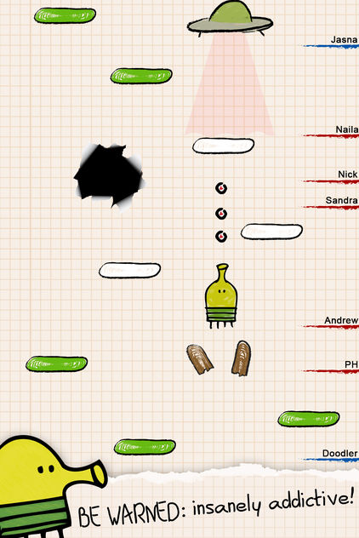
DOODLE JUMP
Doodle Jump is a platformer which replaces traditional movement mechanics with gyroscope controls and automatic jumping, limiting player choice

Slide 3
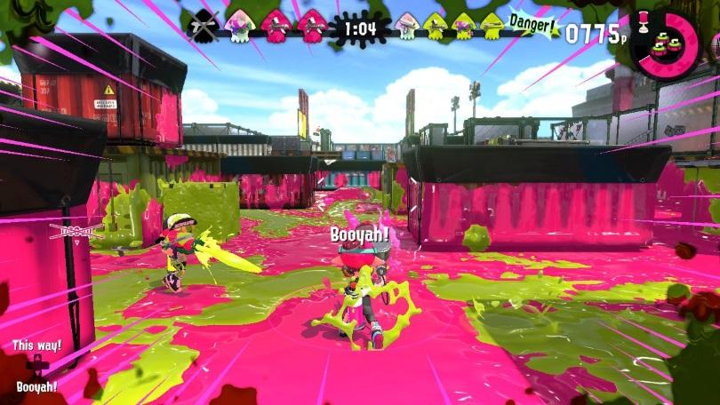
SPLATOON
Splatoon is a third-person shooter where instead of shooting one another, players complete a game mode objective by covering the area in ink.
As well as this, players replenish their ammo by turning into a squid and swimming through their own paint colour rather than traditional reloading
For example, in Turf Wars, the team with the most ground covered by the ink colour at the end of the timer is the winner

Slide 4
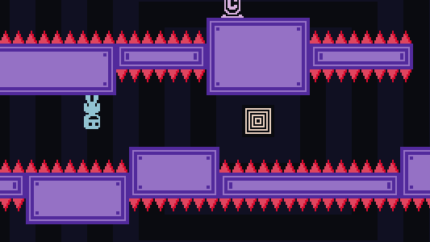
VVVVVV
VVVVVV is a retro-looking 2D platformer where jumping is removed and is replaced with the ability to invert gravity
Players had to flip gravity at the correct moment in order to avoid spikes and progress through the level

Slide 5
Game ideas

Slide 6
IDEA 1 Platformer with no jumping
Genre: Platformer
Mechanic removed: Jumping
New solutions
Players must grow a beanstalk to the correct size in order to allow them to cross gaps between platforms
Length can either depend on the number of beans supplied to the planting patch or the amount of time the player waters the sprout for
If the beanstalk if too short, the player will fall to their death
If the beanstalk is too long, it will grow into the platform and make it break
Themes
Based on stationery, players could hold to pull the length of pencil out of a pen pot until they think it is long enough
Players squeeze an icing bag to create a bridge and help a gingerbread man across gingerbread platforms

Slide 7
IDEA 2 Stealth game with no player movement
Genre: Stealth
Mechanic removed: Character movement
New solution
The player must manipulate the environment around them to stay hidden
The game features AI and works on a turn-based system where the player will move the environment and then the AI will take a turn to move
Could create some movement constraints based on testing
The game could also work in real-time, with AI/environment being moved constantly
Themes
School and trying to avoid being caught skipping lessons
A mouse stealing different ingredients from a pantry and trying to avoid being caught by the owners
Notes:
Stealth game where the character doesn’t move so they have to manipulate the environment around them
Turn based, you move a piece of the environment and then the AI moves

Slide 8
IDEA 3
Maze game where you cannot see but the player solves the puzzle using “echo location”
Themes: A bat or oilbird navigating cave system
Racing game where the car accelerates itself and you can only brake and steer. Maybe use timing/precision to avoid obstacles.
Drag racing game where you shift gears by answering simple maths questions correctly

